Slide 1
LIBRARY MANAGEMENT SYSTEM
- Sri lakshmi ganjam

Slide 2
Contents
Introduction
Problem Statement
Objective
Implementation
Modules
Flow Of Project
Conclusion

Slide 3
Introduction
Library is a collection of different types of books.
It provides books for large number of Readers.
Thus we need a Software for managing the Library.
Library Management System Software provides the systematic handling of books and readers.

Slide 4
Problem Statement
Transaction of books in the institutional libraries have been done manually in most cases, thereby taking more time for transaction like borrowing of books or return of books and also searching of member and books.
Series of problems occur as a result of this thereby resulting to inefficient library management.
In most cases as a result of human error there maybe loss and damages of records due to not using a computerized system in the library.

Slide 5
Objective
The main objective of this project is to develop a computerized system that will manage the activities in the library thereby providing easy access of library usage for librarian and users of the library.
It will also help librarians keep track of library information etc. This system will also provide electronic means of storage and help librarians keep track of library information.

Slide 6
Implementation
Implementation of Library Management System has been done is four Phases.
Java With Collection
JDBC
JPA With Hibernate
Angular With Spring Rest

Slide 7
Java with collections
In java with Collections we have used Array List to store the data of Books and Users.
Array List Implements Lists.
Array List internally uses dynamic array to store elements.
Array List is efficient for Storing and Fetching the data.
Array List provides random access

Slide 8
Why JDBC (java database connectivity)?
In Java With Collections we can store the data temporarily.
In order to over come this problem we move to JDBC, where we can store the data permanently
JDBC is the only API in the world of java to connect java application to RDBMS application

Slide 9
Steps to work with jdbc
Load the Driver
Get the DB connection via Driver.
Issue SQL Query via Connection.
Process the Results returned by SQL Query.
Close All JDBC Objects.

Slide 10
Jpa with hibernate
JPA with hibernate internally uses JDBC.
JPA stands for Java Persistence API is a specification.
Hibernate is one of the implementation of JPA.
JPA internally uses ORM(Object Relational Mapping), it acts as a bridge between java application and RDBMS application.
ORM helps to convert object to data(text) and vice versa.

Slide 11
Angular with spring rest
Spring Rest and Angular working together to provide a pleasant and secure user experience.
We are using Spring Rest as backend technology and Angular as frontend.
@CrossOrigin is used to allow Cross-Origin Resource Sharing (CORS) so that our angular application running on different server can consume these APIs from a browser.

Slide 12
Block Diagram
Home
About
Contact us
Library Management system
Log in

Slide 13
Admin Modules
Register
Add Book
Remove Book
Search Books
View All Books
View All Users
View All Requests
Book Issue
Receive Returned Book
Log Out

Slide 14
User module
Books in Library
Search a Book
Request a Book
Return a Book
Change Password
Log Out

Slide 15
Project flow
Login:- Login is based on role if admin is logged in Admin operations will be
Displayed or if user gets logged in user operations will be displayed.
Database
Enter EmailId and Password
Home
Login
Check Validity
Operations Page
Web server

Slide 16
Add user
If admin is logged in then he can register a user.
Admin Login
User added successfully
Home
Admin adds user
Database

Slide 17
User login
a. Book Search:- If user logged in he /she can search books with the help of book Id, title Or author.
Search by id/title/author
Home
User Login
Show All Books
Displays particular Book
Book Database

Slide 18
User login
Book Request:- If user is logged in he/she can request a book based on userId and BookId.
Request Book
Request placed to admin successfully
Home
User Login
Show All Books
Book Database
Request Database

Slide 19
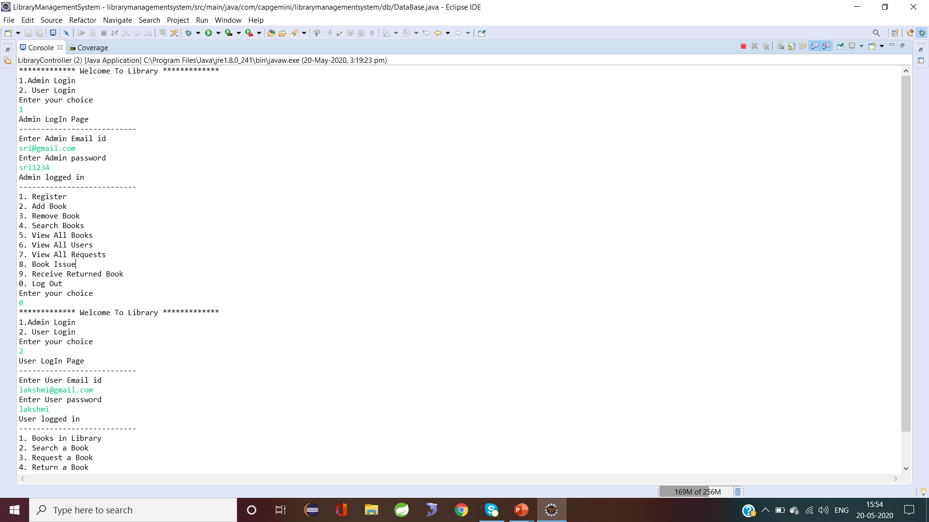
Output for console applications

Slide 20
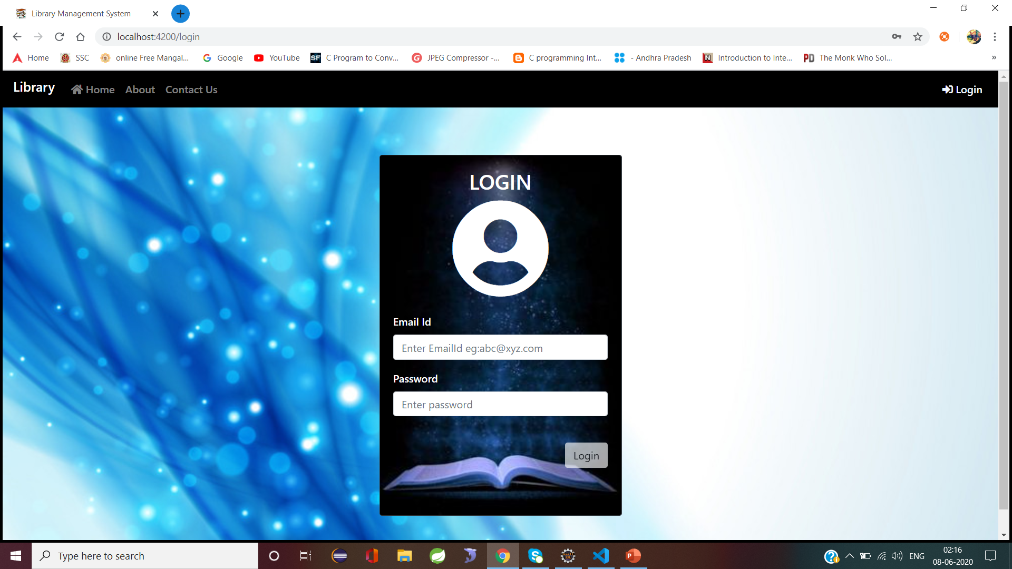
Output for angular with spring

Slide 21
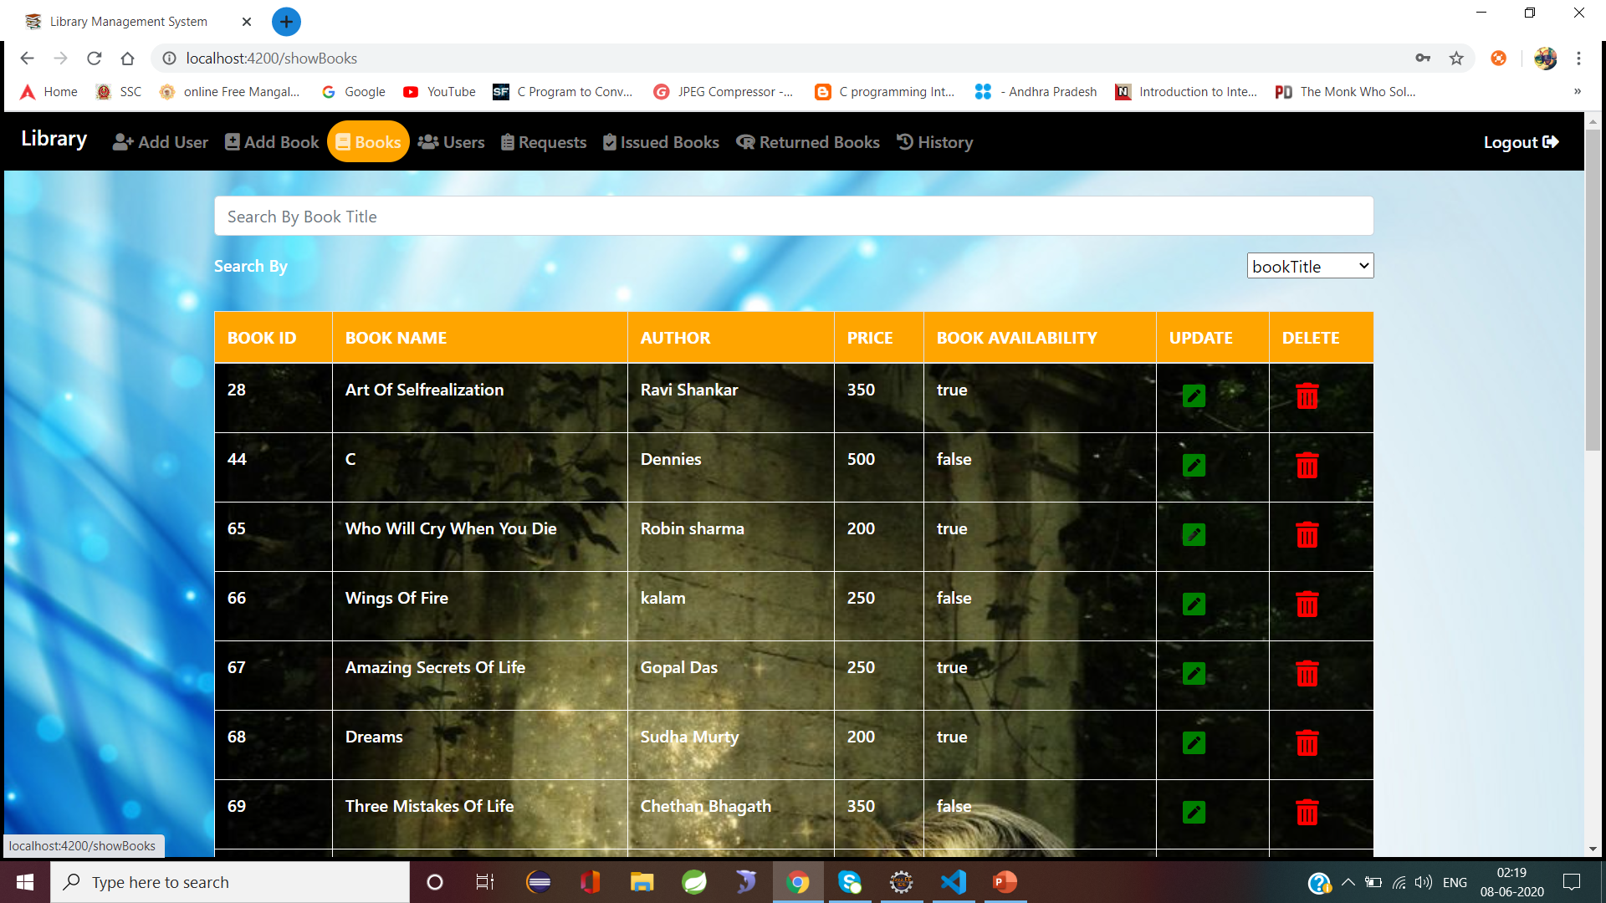
Admin activities page

Slide 22
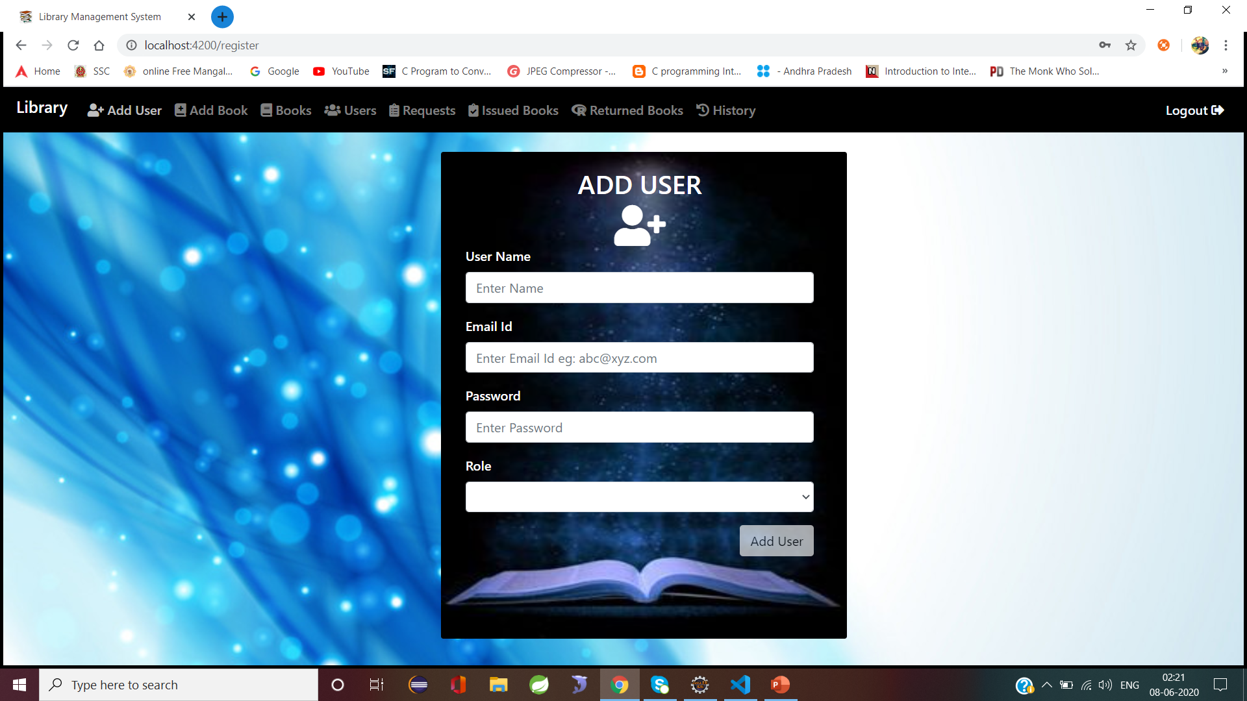
Admin activities

Slide 23
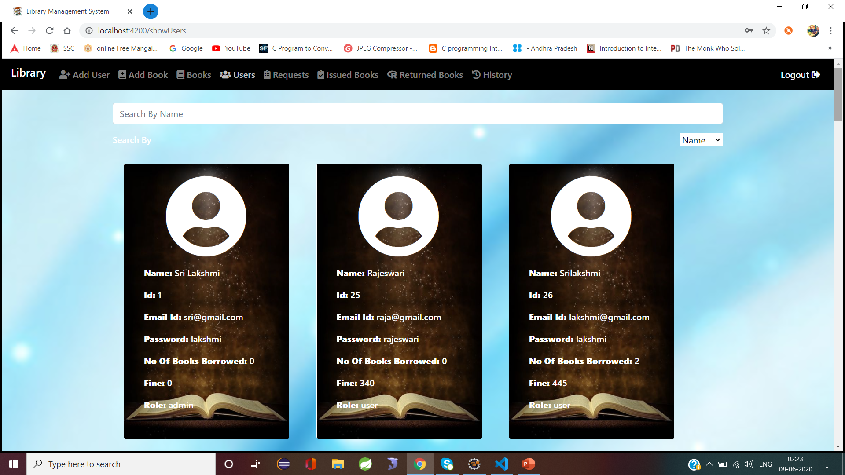
Admin activities

Slide 24
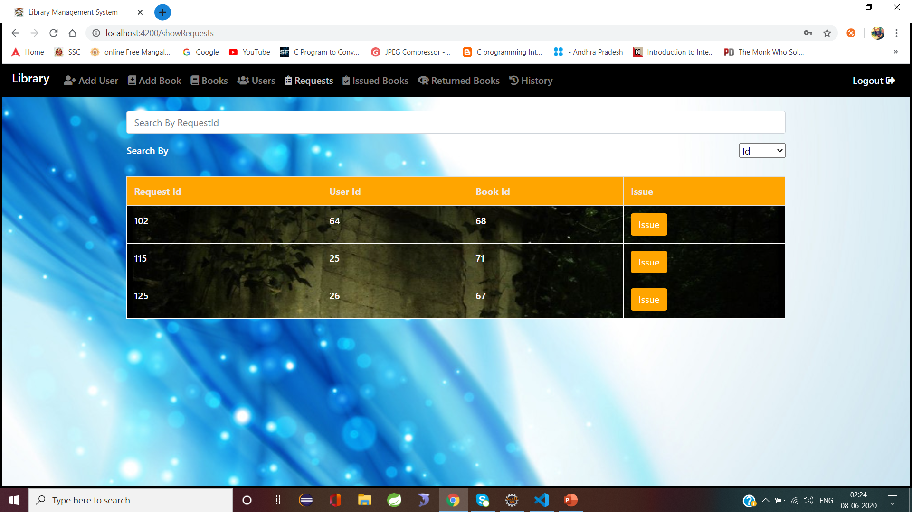
Admin activities

Slide 25
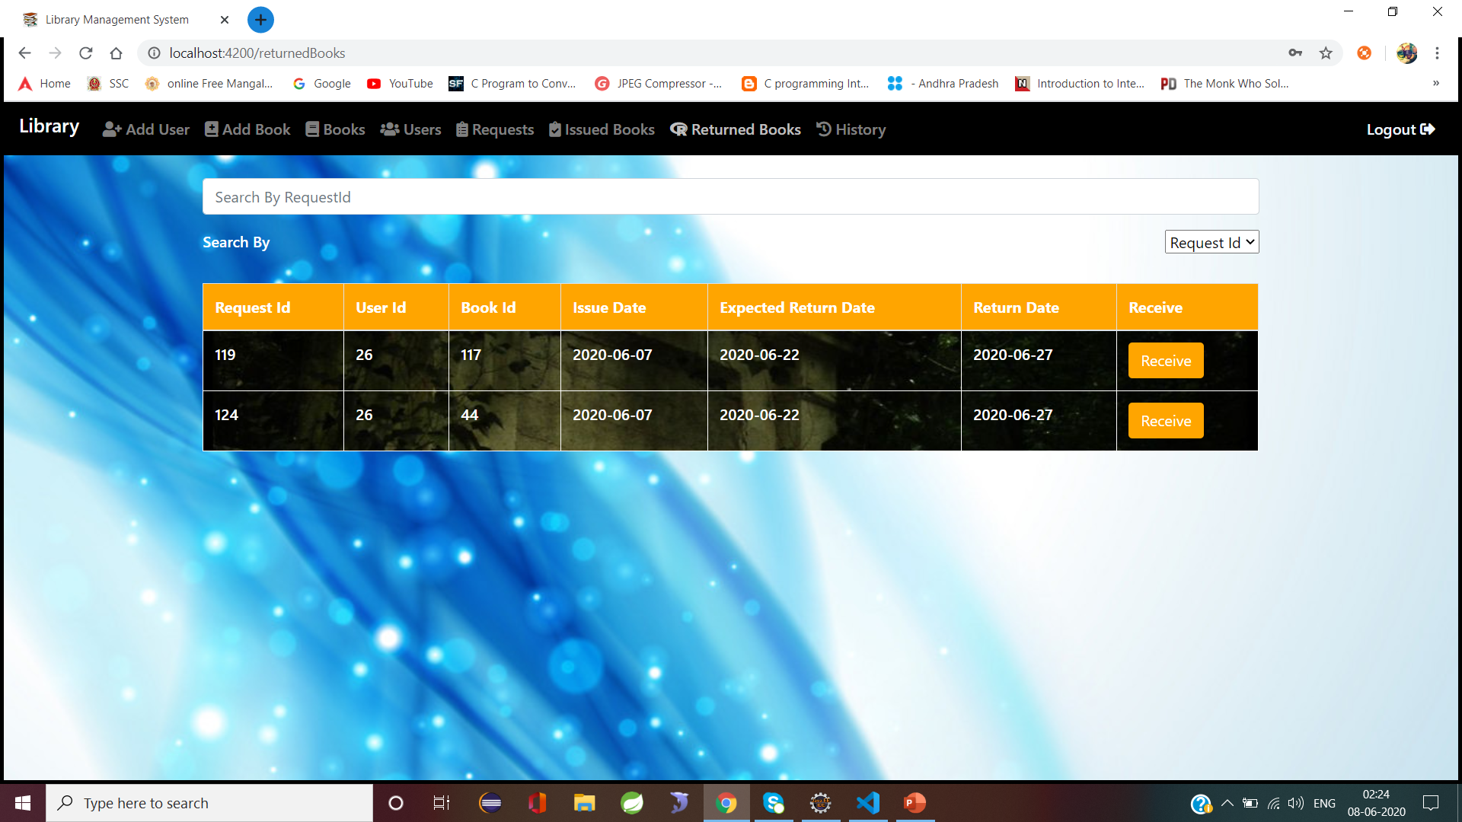
Admin activities

Slide 26
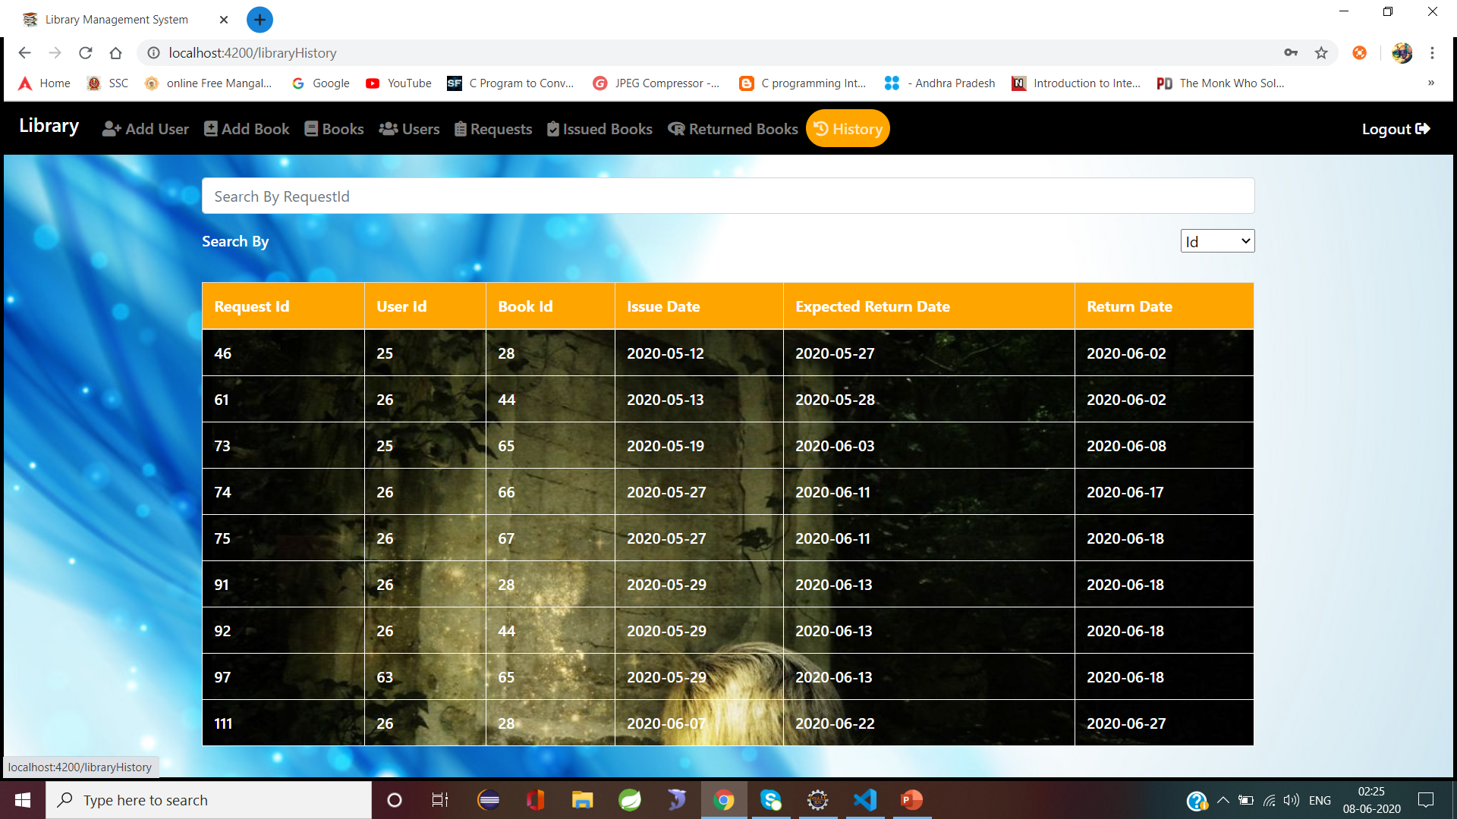
Admin activities

Slide 27
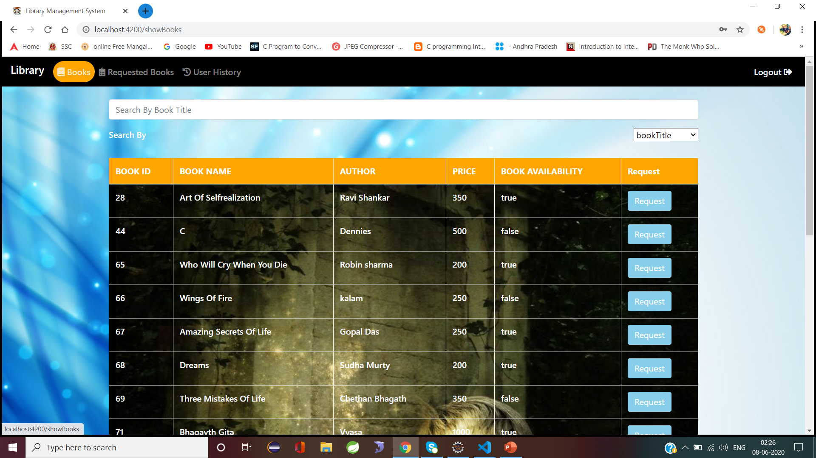
User activities

Slide 28
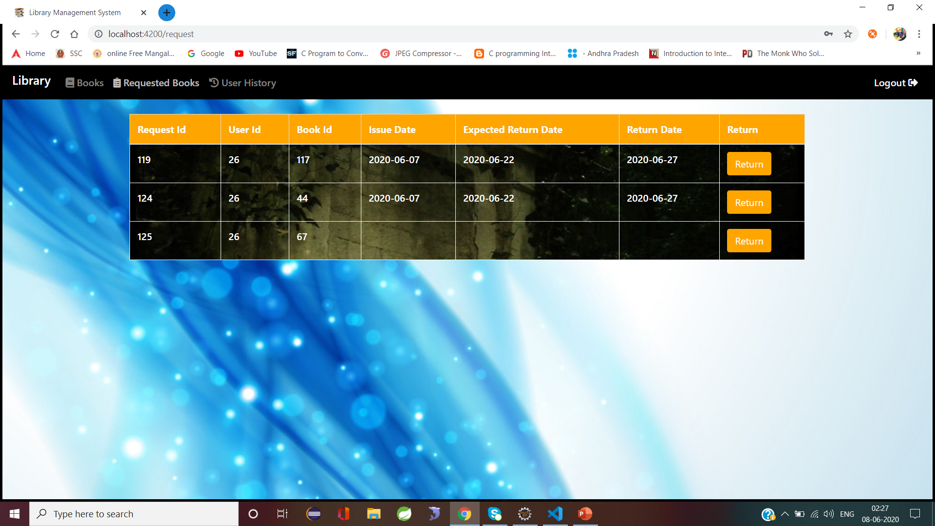
User activities

Slide 29
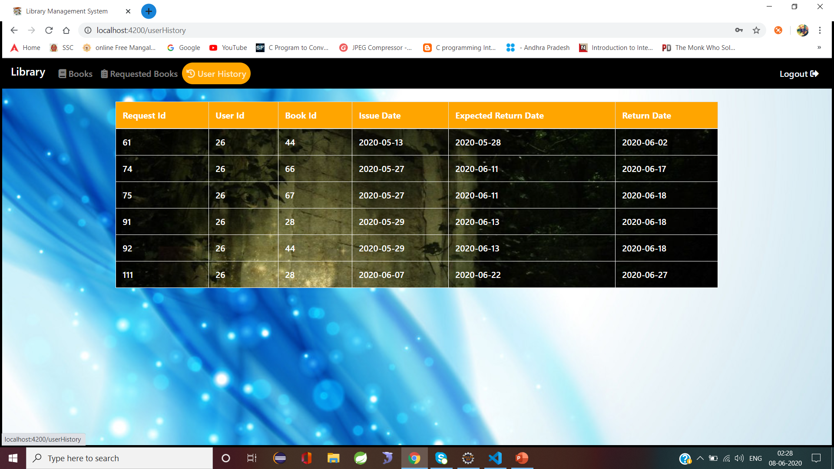
User activities

Slide 30
conclusion
In conclusion, from proper analysis and assessment of the designed system it can be safely concluded that the system is efficient, usable and reliable Library Management System. It is working properly and adequately meets the minimum expectations that were for it initially.
The new System is expected to give benefits to the users and staff in terms of efficiency in the usage of library system

Slide 31
Thank you

